Slide 1
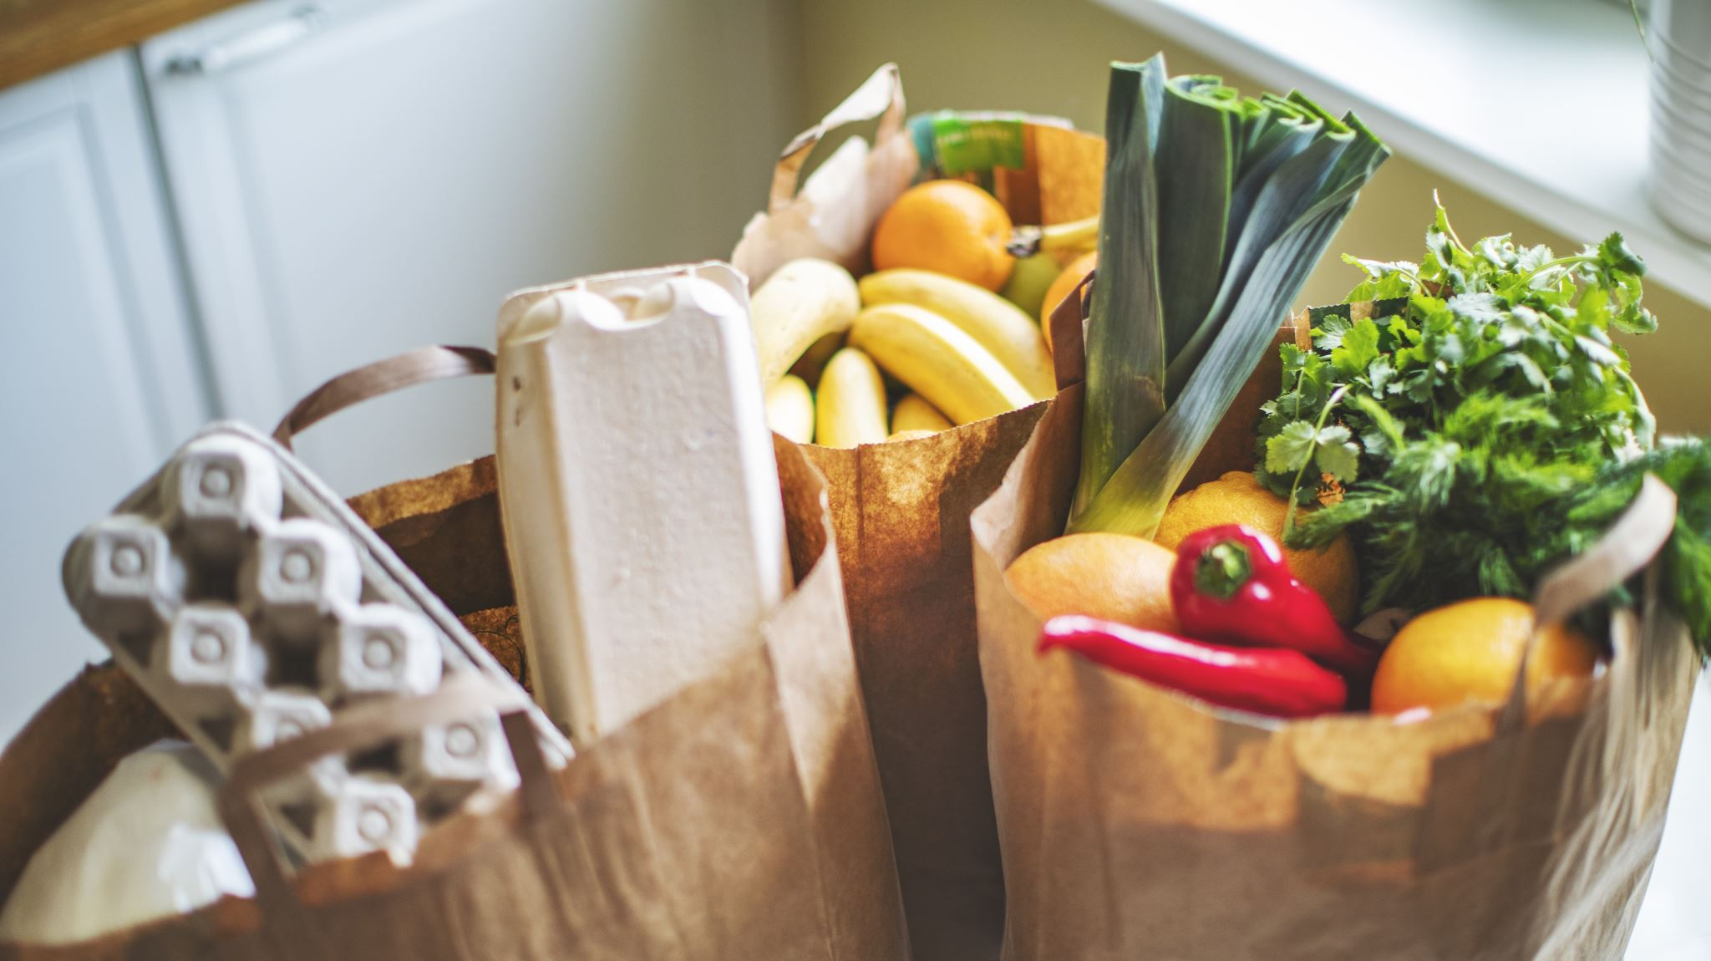
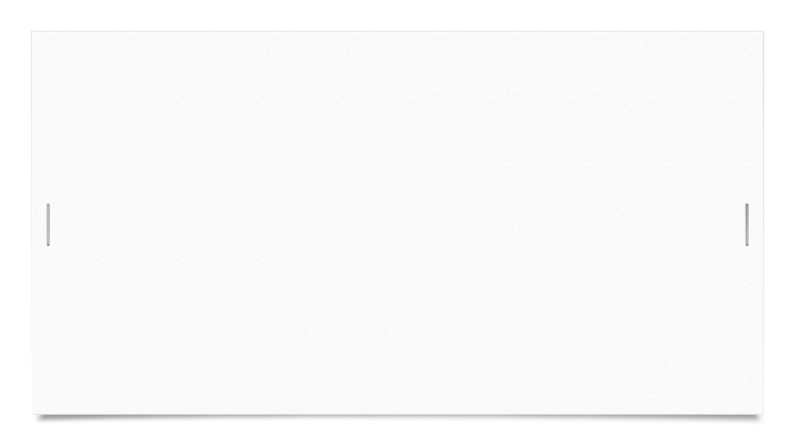

Grocery Delivery Management System
Susan Rogers INFO-C450 – Systems Analysis and Design Instructor: Jafrina Jabin Spring 2026
Project Overview
This project presents a grocery delivery management system designed to help local grocery stores provide online ordering and delivery services. The system allows customers to browse products, place grocery orders, and track deliveries while enabling store managers and delivery staff to manage orders and delivery assignments.

Slide 2
Problem and Solution
Problem
Many local grocery stores do not have affordable systems that allow customers to place orders online and request home delivery. Customers often spend significant time traveling to stores, searching for products, and waiting in checkout lines.
Solution
The Grocery Delivery Management System provides:
• Online product browsing • Grocery order placement • Inventory tracking • Delivery assignment • Delivery status tracking
This system improves efficiency for grocery stores and provides a convenient ordering experience for customers.

Slide 3
System Features
Key Features
• User registration and login • Product browsing and search • Shopping cart and grocery order placement • Inventory management for store managers • Delivery assignment by managers • Delivery tracking for customers • Delivery status updates by delivery staff
Technologies Used
• Java • NetBeans IDE • Java Swing interface • In-memory data storage using Java ArrayLists

Slide 4
System Demonstration
During the demonstration, the following workflow will be shown:
User logs into the system
Customer browses grocery products
Customer adds items to the shopping cart
Customer places a delivery order
Manager assigns delivery staff
Delivery staff update delivery status
Customer tracks the delivery progress
This demonstrates how the system supports the complete grocery ordering and delivery workflow

Slide 5
Future Development
Additional features could include:
• Integration with payment processing systems • Real-time inventory synchronization with store databases • Mobile application support • Enhanced delivery route optimization • Notifications via email or SMS
These improvements would further enhance usability and scalability for larger grocery store operations.

